Slide 1
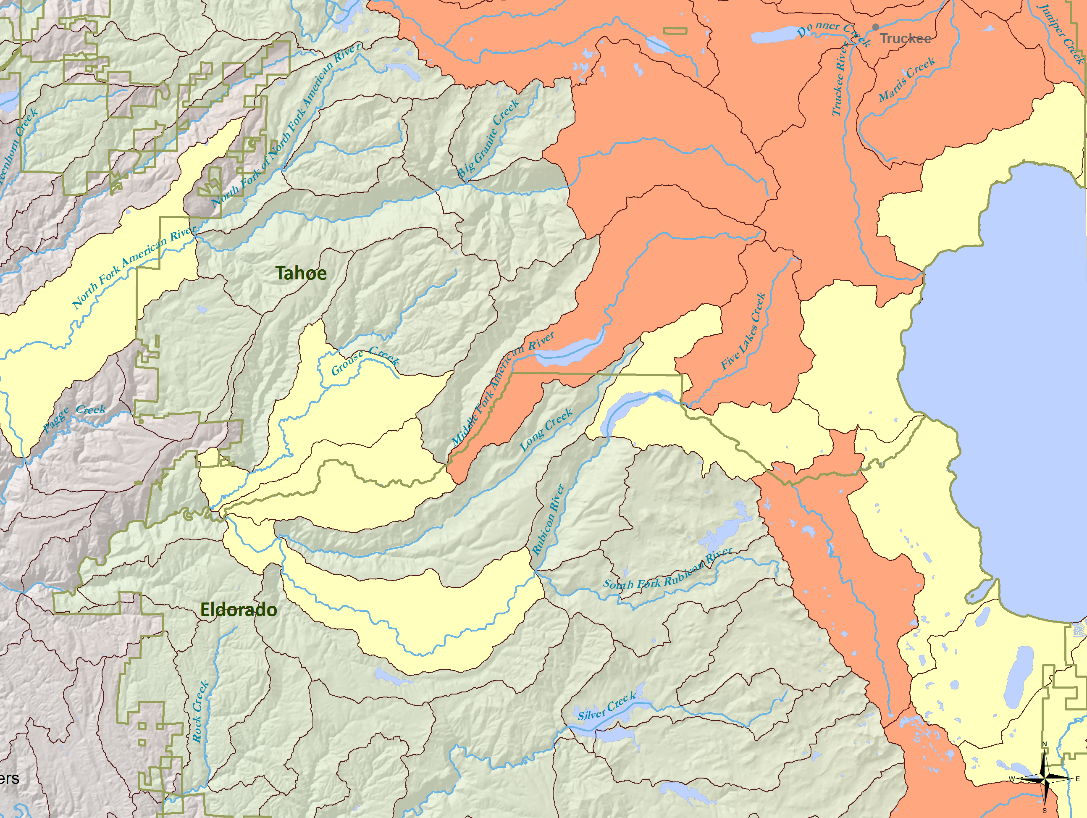
The PISCES Software and Data

Slide 2
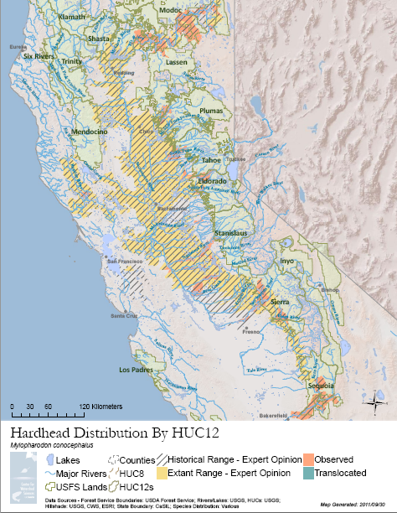

Slide 3
Some PISCES stats
4,583 lines of Python code wrapped around ArcGIS, Microsoft Access, and various libraries
Refined distributions for 50 taxa with historic, current, observed, and translocated populations. Data for 119 of 129 native taxa.
356 forest service specific maps
Tracking data for 200+ taxa – 189 have data
335,000+ data points (272,000 active)
183 imported datasets (and many more waiting) – incl. R5 fish db, forest datasets and others

Slide 4
Observations by Source
Source Data | Set ID | Count
\data\observations.gdb\SNF_FISH_2010 | 57 | 24800
direct addition | 174 | 16099
\data\observations.gdb\Shasta_Trinity | 76 | 14774
\data\observations.gdb\Klamath | 59 | 13526
\data\observations.gdb\Six_Rivers | 78 | 12662
\data\observations.gdb\Tahoe | 61 | 8101
\data\observations.gdb\Sierra | 63 | 7395
\data\observations.gdb\Plumas | 60 | 7163
\data\observations.gdb\Modoc | 66 | 7050
\data\observations.gdb\SFAmerFishEdit_1 | 71 | 6200
\data\observations.gdb\NFAmerFishEdit | 62 | 5954
\data\observations.gdb\blbpoly | 170 | 5025
We received some data from all forests in CA, though some were limited datasets. We also received data from R5 and LTBMU

Slide 5
Review of PISCES
PISCES is software developed for this project that standardizes, maps, and helps us analyze the distribution of fish species in California based on watershed units.
PISCES records:
a species,
in a watershed,
at a time,
with a qualifier,
attributed to a source and source data
and with appropriate metadata
Along with related information PISCES automatically generates appropriate rangemaps that layer multiple data types for all taxa with minimal configuration. Through basic plugins, PISCES generates complex maps that relate biological, climatic, and spatial variables.

Slide 6
System Design
Data Importer
Mapper
Normalizes Data, Tracks It, and Determines Relevant Attributes
Processes Data and Generates Varieties of Custom Maps
Observations
Editable Map Documents (mxds)
Database
Input Filter
Experts (live paint)
Input Filter
Plugins
Models
Reports
Cached Distributions
Maps

Slide 7
What can we do?
Standardize data
Store metadata of our own and of PISCES’s determination
Trace data back
Generate large numbers of maps with varying data and extents very quickly.
Ask powerful questions easily and get the results as a set of maps.

Slide 8
Major Features
Incredibly flexible and powerful input and output systems for loading and exporting data
Contains distribution data for sensitive species
Refined mapping and interaction tools
Robust metadata storage – includes the ability to collect observations into datasets
All code and data under version control
Won 2nd place for software integration at 2011 ESRI User Conference (field size > 2).

Slide 10
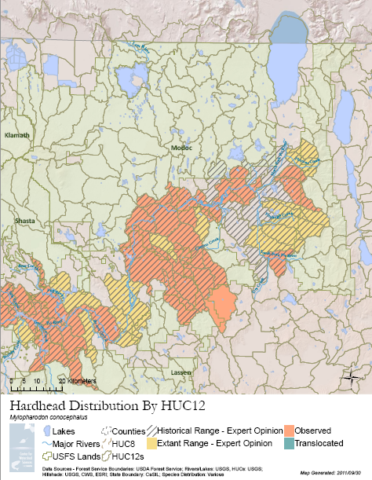

Slide 11
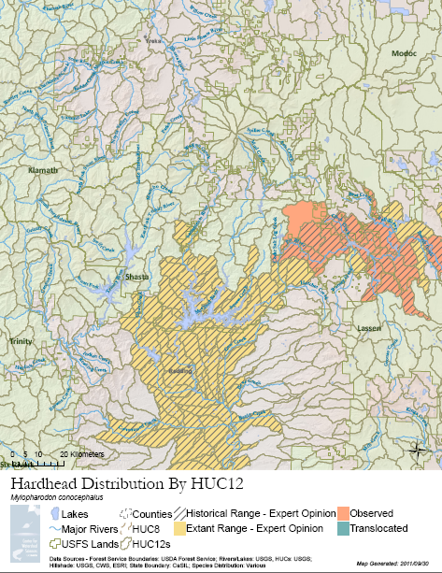

Slide 12
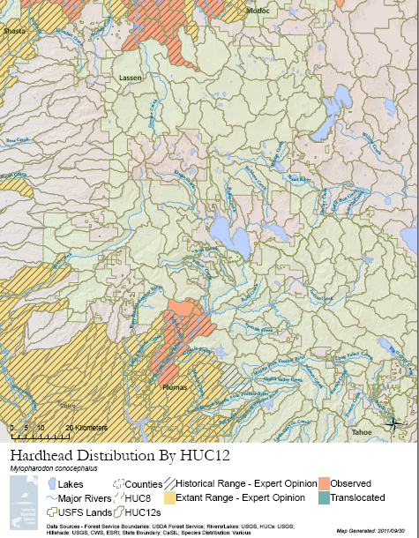

Slide 13
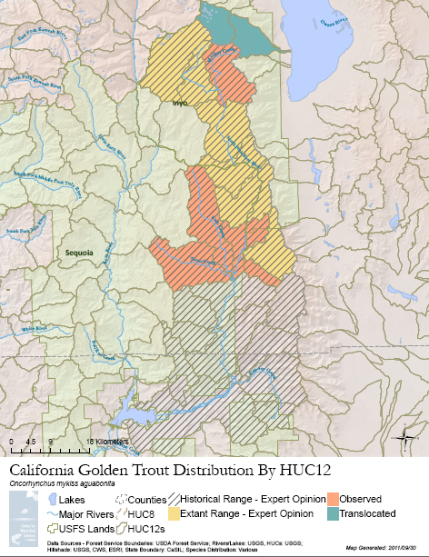

Slide 14
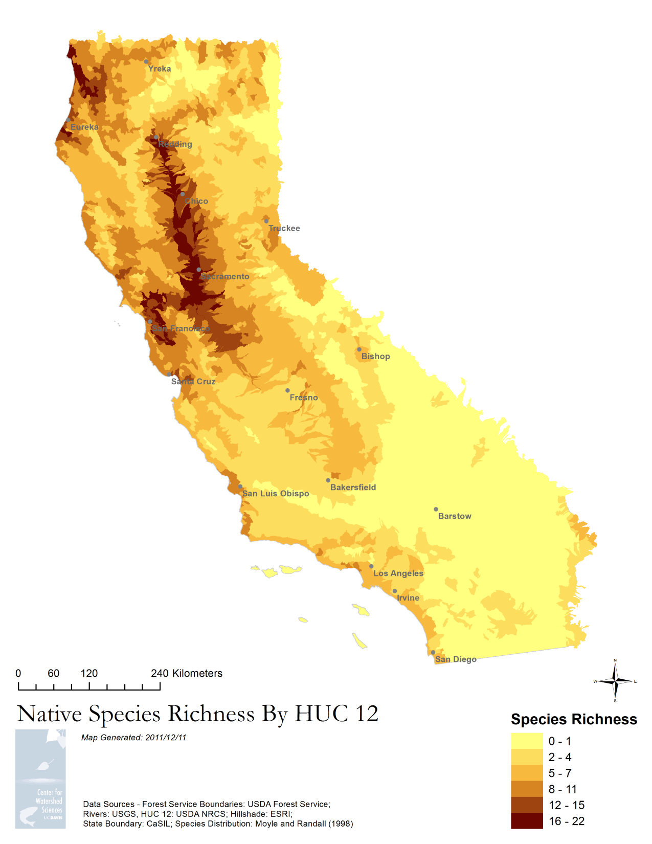

Slide 15
